Slide 1

Final Project DS 5110: Introduction to Data Management and Processing Amazon Best Seller Analysis in Discovering Consumer Preferences and Production Performance
Team Members:
Runying Chen
Bohan Cao
December 3, 2024

Slide 2
Agenda
Introduction
Literature Review
Methodology
Results
Discussion
Conclusion

Slide 3

"If I want to succeed as an Amazon seller and thrive in e-commerce, how do I decide what to sell?
What are the trending products and best-selling categories in real-time?"

Slide 4

Introduction
Background:
Growth of e-commerce, Amazon's role in global retail.
Objective:
Analyze Amazon’s bestseller lists to understand market trends, consumer preferences, and pricing strategies.
Data:
Collected on October 16, 2024, from Amazon's bestseller lists across 36 categories.

Slide 5

Literature Review
Key Research:
E-commerce and consumer interest (Trzebiński & Marciniak, 2023).
Challenges of outdated data and static datasets.
Importance of dynamic data collection for current insights (Zhang, 2024).
Gap: Real-time data, interactive visualizations, and broader category analysis are underexplored.

Slide 6
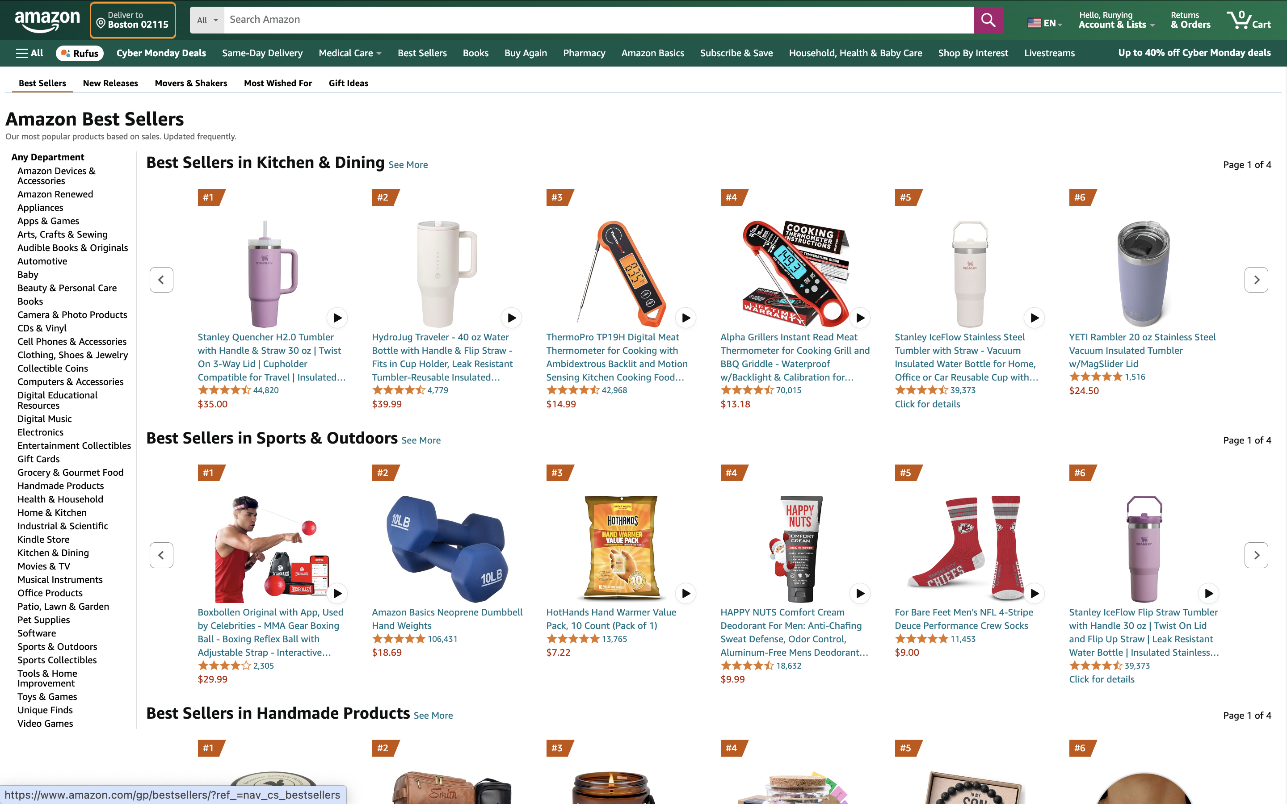
How can we extract data from Amazon's Best Seller pages in Real –Time ?
Link: https://www.amazon.com/gp/bestsellers/?ref_=nav_cs_bestsellers

Slide 7
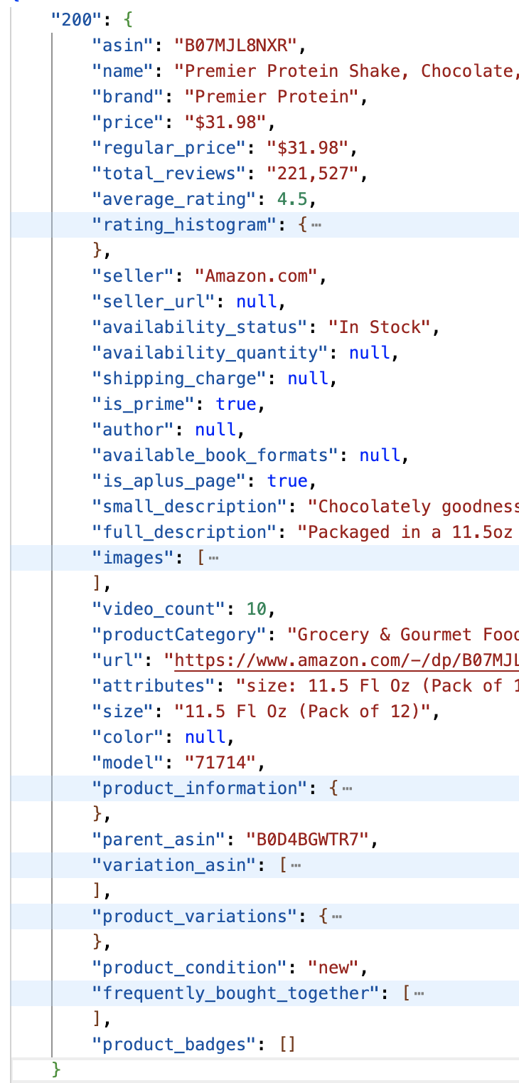
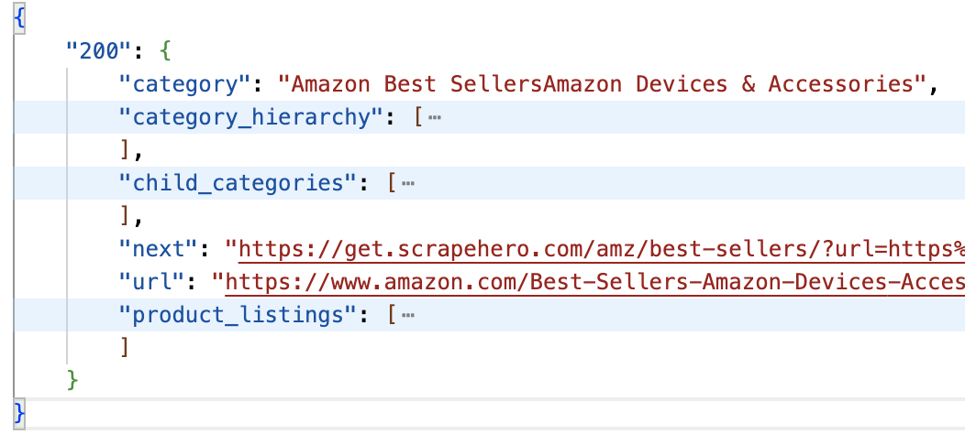
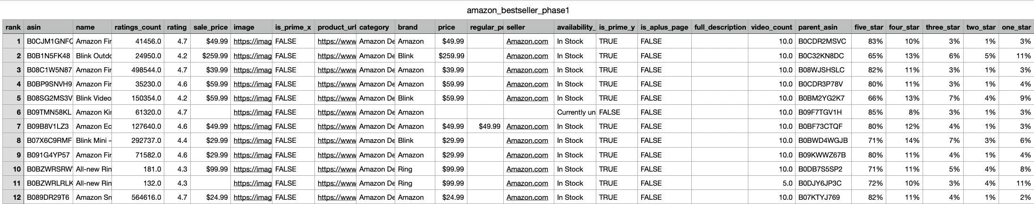

Methodology: Data Collection
Tool Used: ScrapeHero API – API Request
Two Datasets
Top 20 products across 36 categories, and 720 products in total
Product detail data for the 720 products
Automation Pipeline – Developed Python Functions:
Pull unique ASIN from Raw data
Make batch API requests for product detail
Convert Json data to CSV format
Integrate datasets

Slide 8
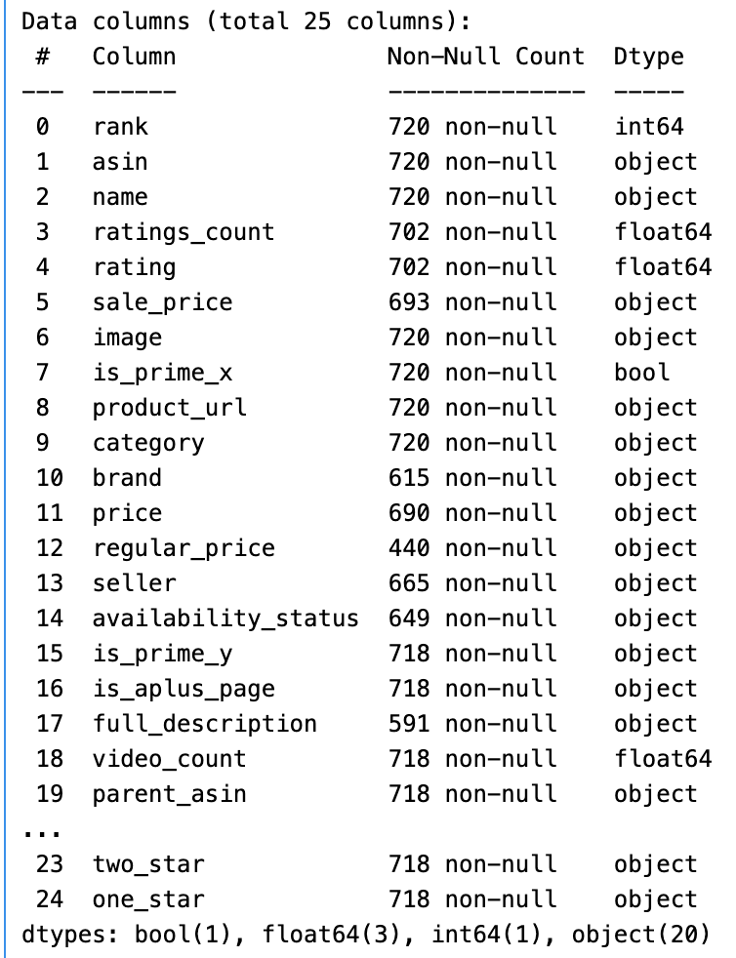
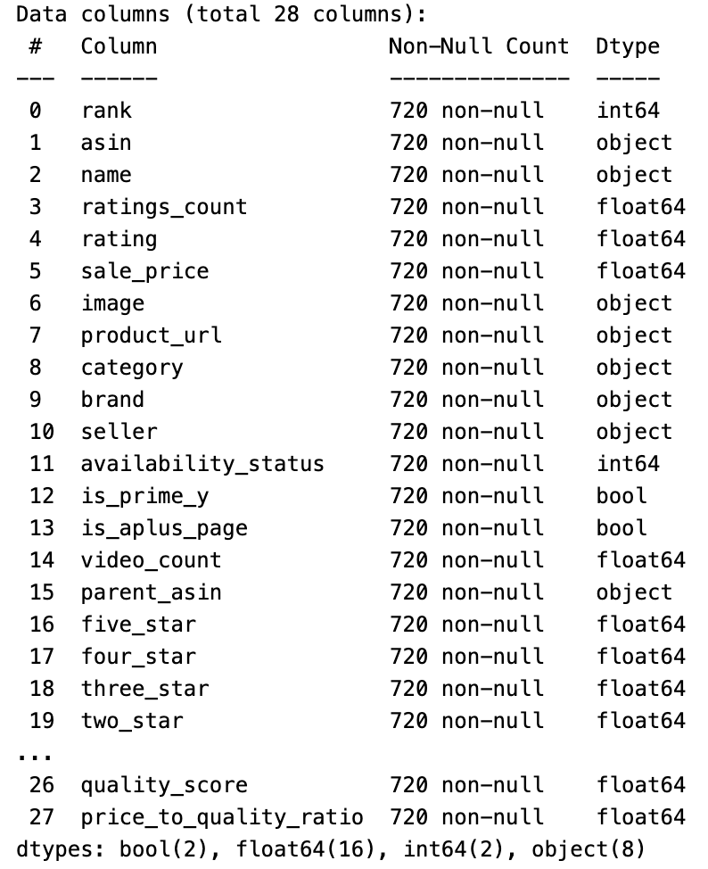

Methodology: Data Preprocessing
Handle Mission Value
Filled gap using product URLs and Python functions
Replaced missing value entries with true data or with placeholders for consistency
Removed Redundant Columns
Dropped non-useful columns, overlapped columns, columns with lots of missing value
Standardized Data Types
Used correct data type
Transformed string (with $) to float
Used binary value for availability status
Outlier Detection & Scaling
Z-score normalization to detect outliers in numerical data (e.g., sale price, ratings count).
Min-Max scaling for better comparability between features
New Metrics (Added new columns)
Estimated Revenue: Ratings Count x Sale Price
Price-to-Quality Ratio: Assessed product value relative to quality

Slide 9

Analysis Techniques
Correlation Analysis: Identified relationships between key variables.
Descriptive Analytics: Visualized category-level and product-level insights.
Textual Analysis: Used NLTK to analyze product titles for popular keywords.
Visualization Tools: D3.js, Recharts, React for interactive visualizations.

Slide 10
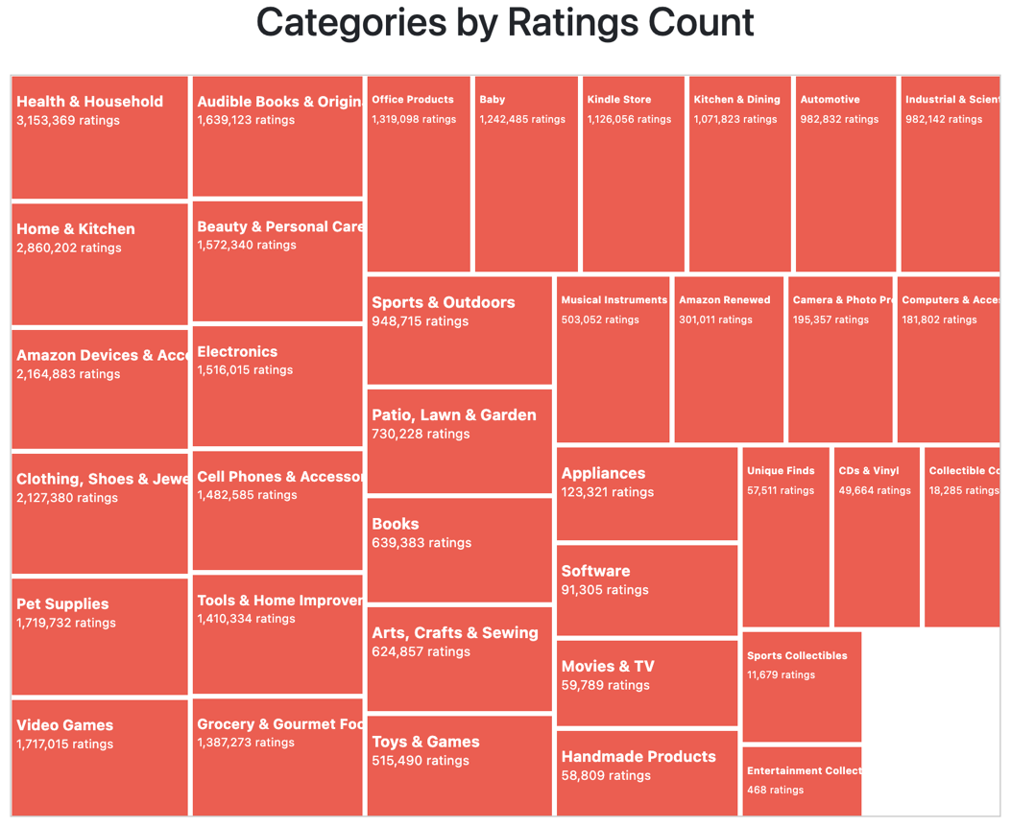
Result: Tree map 1
The treemap shows that categories such as Health & Household, Home & Kitchen, and Amazon Devices & Accessories have the highest customer engagement and satisfaction, as indicated by their large number of ratings.

Slide 11
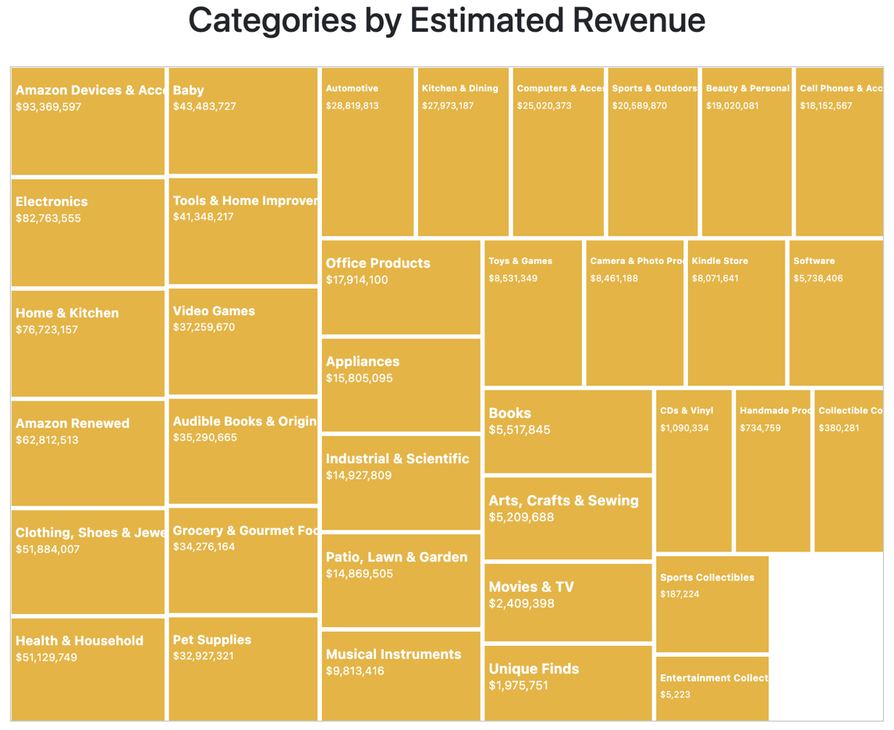
Result: Tree map 2
The treemap reveals that Amazon Devices & Accessories, Electronics, and Home & Kitchen lead in revenue, while Health & Household shows high customer engagement, suggesting that volume-driven sales contribute significantly to its success despite lower prices.

Slide 12
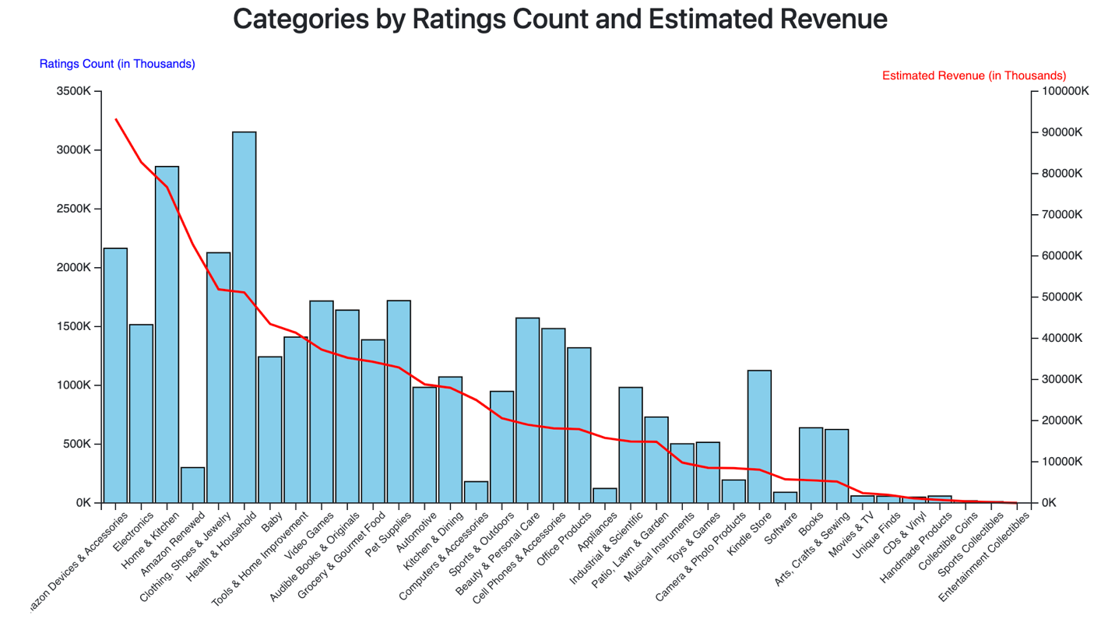
Result: Dual-axis chart
The dual-axis chart shows that categories like Amazon Devices & Accessories, Electronics, and Home & Kitchen lead in both customer ratings and revenue, indicating a strong link between engagement and sales performance.

Slide 13
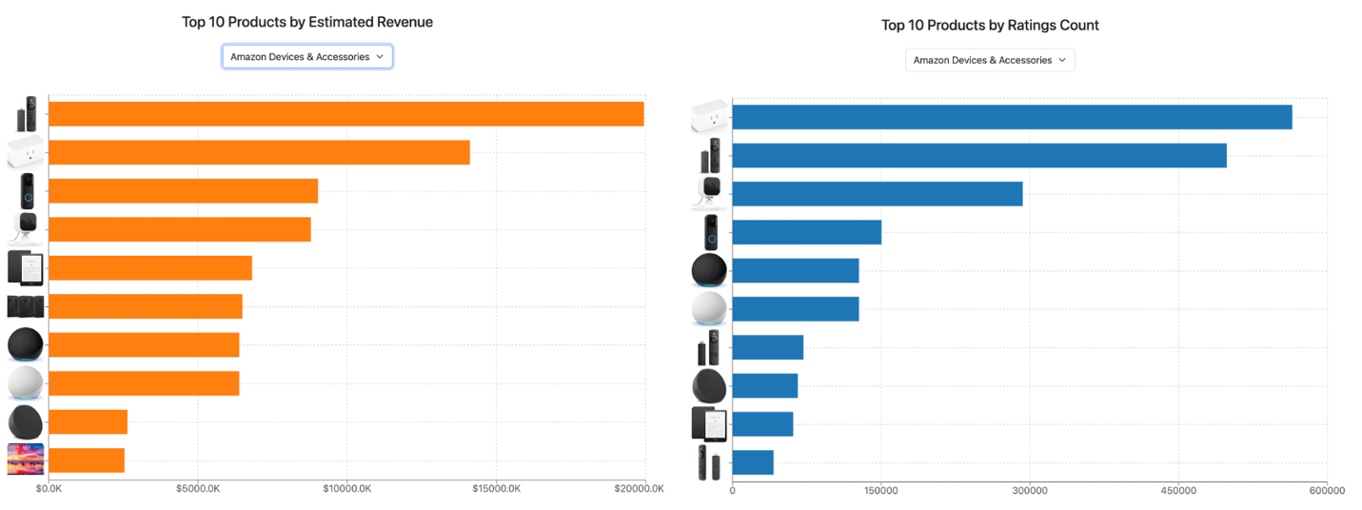
Result: Bar chart 1 Amazon Device & Accessories
Top-performing products like the Amazon Echo Dot, TV remotes, and Kindle drive revenue in the Amazon Devices & Accessories category through innovation and meeting consumer demands for convenience and entertainment.

Slide 14
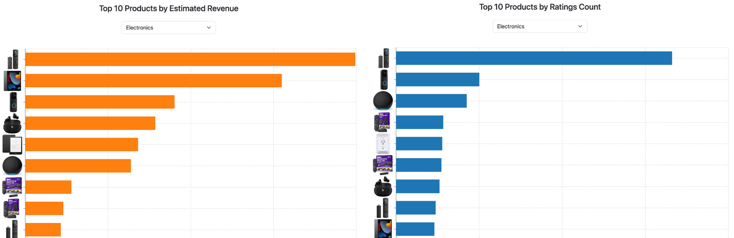
Result: Bar chart 2 Electronics
Products like the Amazon Echo Dot, Kindle, and Fire TV Stick dominate the Electronics category, with the Fire TV Stick driving significant sales and customer engagement due to its versatility and ease of use.

Slide 15
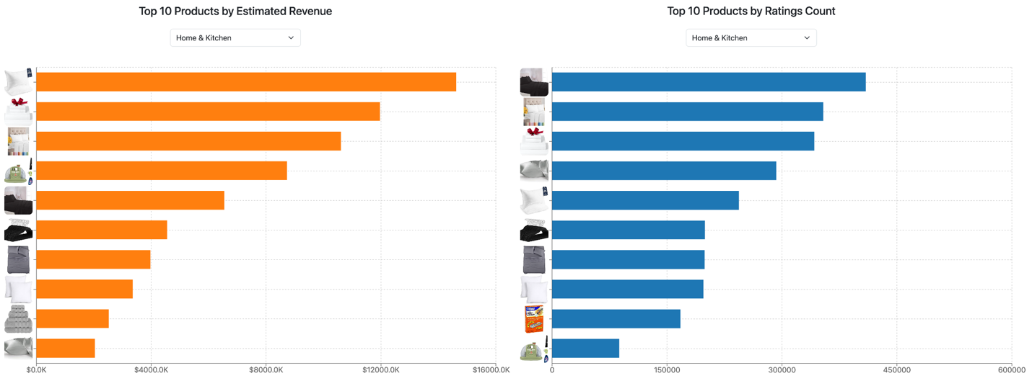
Result: Bar chart 3 Home & Kitchen
Bedding products like bed sheets, pillows, and pillowcases lead the Home & Kitchen category in both revenue and ratings, reflecting growing consumer investment in sleep quality and comfort.

Slide 16
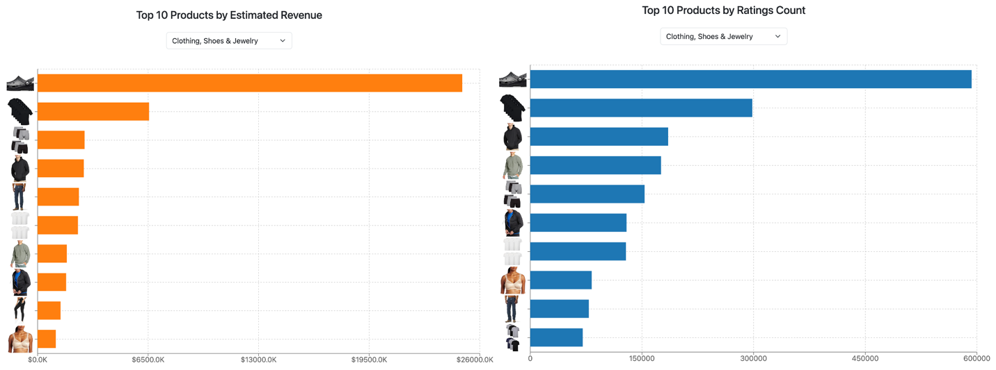
Result: Bar chart 4 Clothing, Shoes & Jewelry
Clogs dominate the Clothing, Shoes & Jewelry category, while men's clothing, particularly jackets and hoodies, outperforms women's fashion, indicating a shift towards greater male engagement in online fashion shopping.

Slide 17
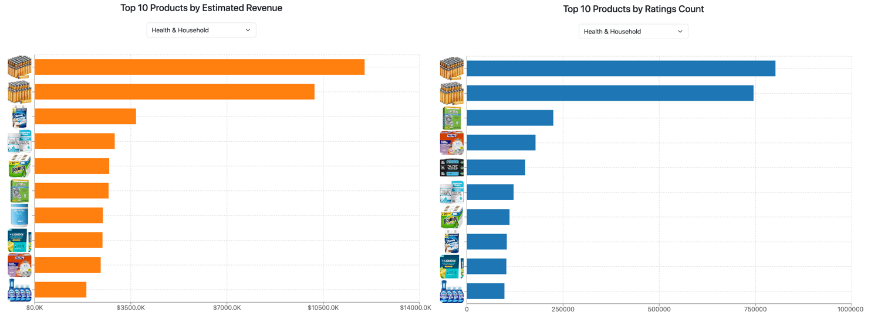
Result: Bar chart 5 Health & Household
Amazon Basics High-Performance Batteries dominate the Health & Household category in both revenue and ratings, reflecting strong consumer trust in Amazon's in-house brand for essential products.

Slide 18
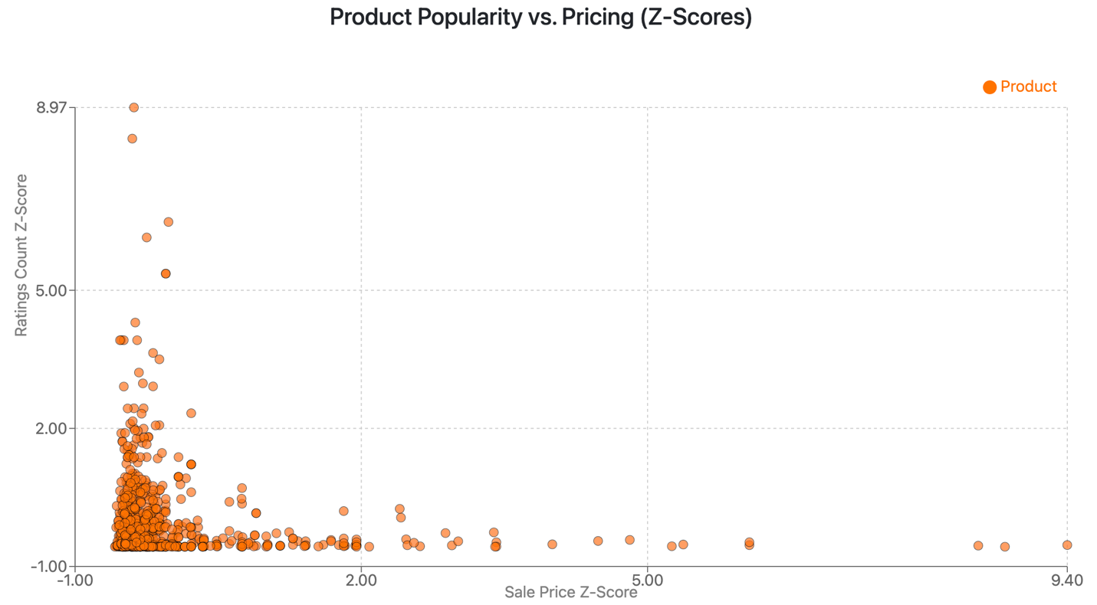
Result: Scatter Plot
The scatter plot shows that lower-priced products receive more ratings, indicating greater popularity, while higher-priced items tend to attract fewer buyers.

Slide 19
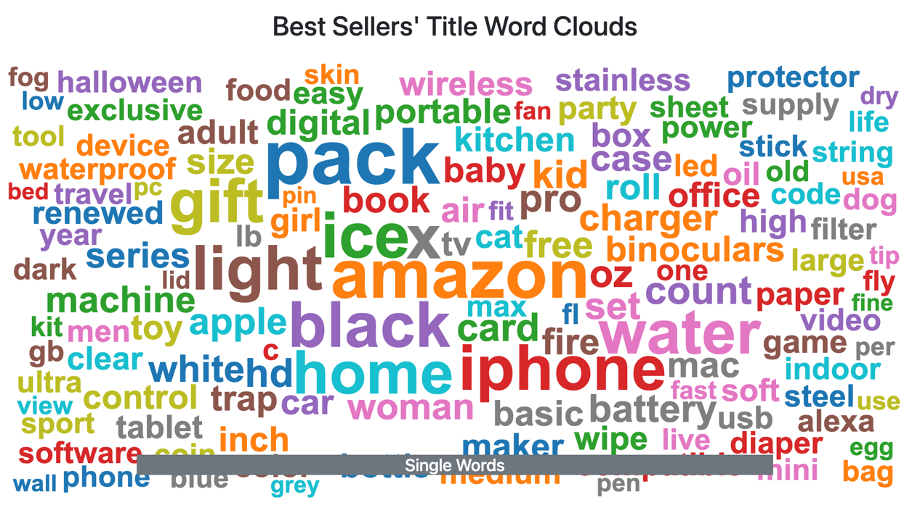
Result: Word Cloud 1 Single Words
The word cloud reveals that popular terms like "pack," "gift," "iPhone," and "home" highlight consumer interest in multipacks, technology, home items, and gift-oriented products.

Slide 20
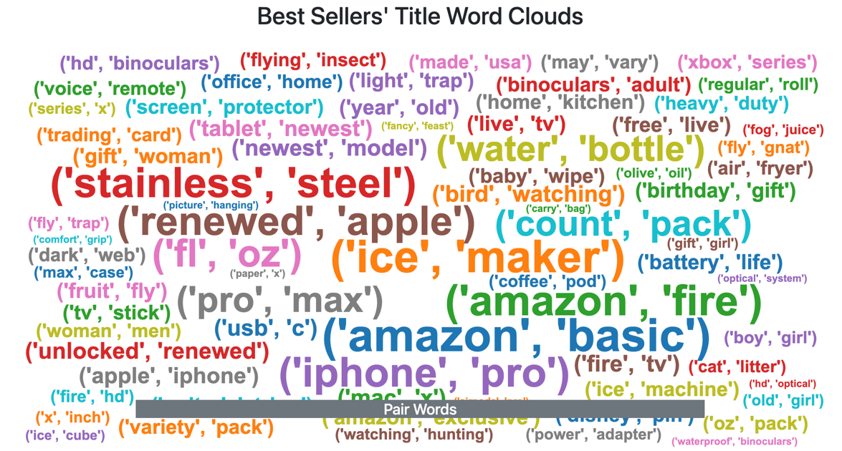
Result: Word Cloud 2 Pair Words
The word cloud of bigrams highlights trends in consumer preferences, such as demand for refurbished Apple products, bulk purchases, hydration items, and gifts for special occasions.

Slide 21

Discussion
Key Findings:
Amazon Devices & Accessories and Home & Kitchen lead in both ratings and revenue.
Health & Household shows high engagement but lower revenue.
Price sensitivity plays a major role in consumer behavior.
Consumer Behavior: Products with convenience and value perform best.

Slide 22

Conclusion
Summary: Key categories performing well in terms of engagement and revenue.
Insights: Price sensitivity, product features like "pack" and "gift," and the importance of customer engagement.
Future Research: Use diverse data sources, seasonal trends, and marketing campaigns.

Slide 23
Dashboard Demo Time

Slide 24
Thank you! Any Questions?

Slide 25
References
Trzebiński, W., & Marciniak, B. (2023). E-commerce consumers' interest in product features. Journal of Internet Commerce, 22(2), 224–243.
Zhang, H. (2024). Personalized recommendation system for e-commerce. Applied Mathematics and Nonlinear Sciences, 9(1).

